Slide 1


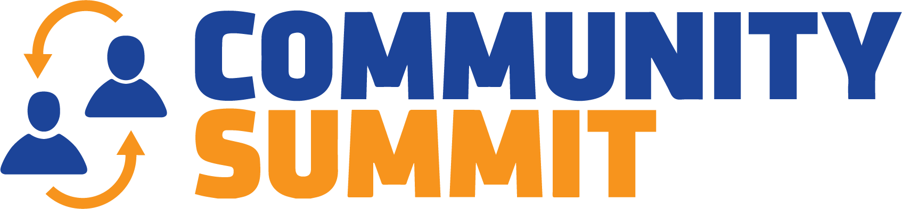

2023

Slide 2
How to Achieve Stability After Dynamics 365 F&O/AX Go-Live

Slide 3
Introduction to Caf2Code and PolyQuest.
Road to Partner of Record
First Stop: Identifying and Understanding Post-Go-Live Pain Points
Second Stop: Assessing Business Needs and Performance Gaps
Final Stop: Developing Solutions to Stabilize Dynamics 365 Finance and Operations
Winners Circle: Building a Trusting and
Cohesive Partner-Client Relationship

Slide 4
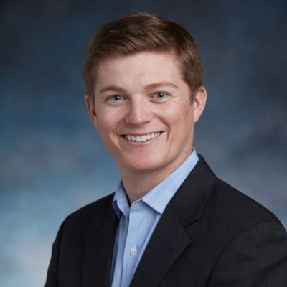
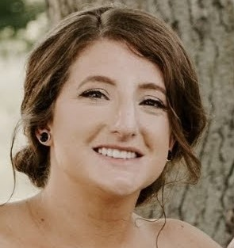

Who are we?
Colin Greenwell Information Systems Manager
PolyQuest Inc
colingreenwell@polyquest.com
Lauren Wooll
Solutions Architect
Caf2Code LLC
l.wo21@caf2code.com
Brittany Burke
Solutions Architect
Caf2Code LLC
brittany@caf2code.com

Slide 5
How the Journey Began
PolyQuest Backstory
  The Value-Added Distributor of Virgin Thermoplastics and Manufacturer of Recycled Thermoplastics
  Outgrew legacy ERP (Microsoft GP)
  Conducted a formalized system selection process to decide on D365 F&O
  Began implementation in August 2019
  Went live on D365 F&O in April 2021 (big-bang approach)
Caf2Code Backstory
  Founded in 2017.
  Microsoft Solutions Partner.
  Focus centered around CPG and its end-to-end supply chain
  Joined the Emerging Partner Cohort for Business Applications in February 2023.
PolyQuest Began working together with Caf2Code in August 2021
Partner of Record 1/1/22

Slide 6
Road to Partner of Record

Slide 7
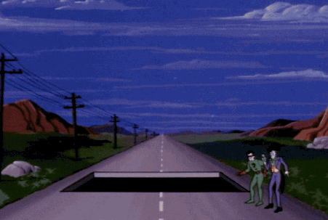
First Stop: Identifying Post-Go-Live Paint Points

Slide 8
Identifying Post-Go-Live Pain Points
Importance of prioritizing key pain points
Defining the gap between desired system functionality and actual performance
Steps taken by the teams to:
  Understand business processes and customizations already in place
  Engaging with end-users and stakeholders for biggest issues
  Determine which is the biggest issue not who is screaming the loudest

Slide 9
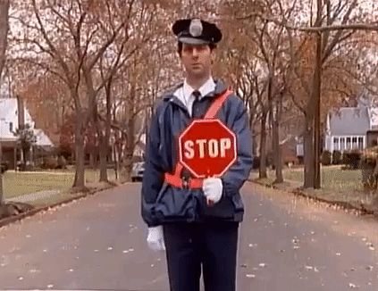
Second Stop: Assessing Business Needs and Performance Gaps

Slide 10
Assessing Business Needs and Performance Gaps
  Understand the business requirements and expectations from all parts of the business
          Level of Effort-low hanging fruit
          Reinforce confidence in the system
  Identify areas where the system does not meet those requirements.

Slide 11
Examples
Quick wins
Expectations v Reality
  Physical v Financial Costing
  What data was going in verses what reports were showing
  Timing of transactions
  Finance- putting months on hold

Slide 12

Final Stop: Developing Solutions to Stabilize Dynamics 365 F&O

Slide 13
Developing Solutions to Stabilize
Dynamics 365 F&O
  Steps taken to prioritize, design, and develop solutions.
    Finding solutions to stabilize or establish a workaround while other issues get resolved
    Building out solutions and controls to benefit the entire business process- not just one issue at a time.
    Future proofing solutions- asking the questions for long- and short-term impact

Slide 14
Examples/Scenarios
  Scenarios- proof in the concept
    Continuous improvement and forward-thinking solutions
    Inventory Costing
  Laying out the options- poking holes to decide which was the right option
    Manufacturing Controls
    Advanced Warehouse updates
      Asking the right questions
      Take a step back
      Reimplement the right way

Slide 15

Winners Circle: Building a Trusting and Cohesive Partner-Client Relationship

Slide 16
Building a Trusting and Cohesive
Partner-Client Relationship
v
Importance of trust and collaboration to run a successful system.
Strategies employed by Caf2Code and PolyQuest to foster a strong partnership.
  Regular communication and feedback loops
  Proactive issue resolution and timely updates
      Solutions that fix the problem and are forward looking.
  Transparent decision-making processes
Involvement from both teams on proposals, controls, and changes to system

Slide 17
Lessons learned and best practices
v
Testing- with guidance from someone who knows the system-your partner.
  Documentation is key- so issues can be revisited quickly and things will be done accurately any time it needs to be revisited.
Not just running through the process- but running through it the right way for the entire business
  IE: Posting profiles
Welcoming business process change- using the system to its full advantage

Slide 18
Lessons learned and best practices.
v
You don’t know until you know
  Understanding what all the options are- weigh their pros and cons in relation to the business needs/processes
Education on the system as it applies to the business and what it can and cannot do in relation to that
  Why choices and configurations were made

Slide 20
Thanks!
Colin Greenwell Information Systems Manager
PolyQuest Inc
colingreenwell@polyquest.com
Lauren Wooll
Solutions Architect
Caf2Code LLC
l.wo21@caf2code.com
Brittany Burke
Solutions Architect
Caf2Code LLC
brittany@caf2code.com

Slide 21

© 2023 Dynamic Communities. All rights reserved.

