Slide 1




2023

Slide 2

Choosing the Right Dynamics 365 F&O Reporting Tool for the job

Slide 3


Lauren Wooll, Solutions Architect, Caf2Code
l.wo21@caf2code.com
Lenore Flower, Senior Business Intelligence Analyst, Caf2Code
l.fl21@caf2code.com

Slide 4
What will you learn today?
Understand the reporting options available for D365 F&O, the Power BI Service, and where to find them
Identify which reports to use given different reporting requirements
Learn about what reports are offered out of the box by D365 F&O and how those can be quickly manipulated to get users what they need fast

Slide 5




Your Main Reporting Options
D365 OOB
D365 Embedded
Power BI Paginated
Power BI Standard
Excel
Notes:
When you think of Reports, most people automatically think of a Standard Power BI Report, but there are other—and often better—options to consider depending on your needs.
In general, we encourage our clients to explore how to meet a reporting need in this order, starting with determining if a report:
1. is already available out of the box from D365 FO
2. If the report can easily become available in D365 FO by creating an D365 Embedded Report
3. If the report has specific requirements that are best met with a Power BI Paginated Report
4. If the report is best experienced as a “Standard” Power BI Report (either optimized for mobile or desktop)
5. And finally, if the specific need would best be met by using Excel instead, either through OData or by connecting to an existing dataset
Each of these has specific strengths and weaknesses, which we’ll discuss in greater detail throughout this presentation.

Slide 6
First Step: Confirm You Actually want a Report
Common Non-Reports masquerading as report requests:
Processes (e.g., validation & approval )
Data Input needs
Vague requests based on “vapor data”
Personalization of an existing D365 FO report
Notes:
Before we go through that process, however, it’s a good idea to start by determining if what’ being requested is a report at all. Often, when you're embarking on a new ERP project, you start by collecting a list of reports from various departments and individuals. Part of this process inevitably involves picking through some "non reports" that people included out of confusion or uncertainty.
Examples of Common Non-Reports we’ve seen requested as reports in the past are:
1- Processes: Often this will be framed with words like “we need a way to document approvals” or “We need a mechanism that will validate each purchase order…”. Processes questions and needs are critical to document and raise to the right people, but they’re generally not reports.
2. Facilitating Data Input is not *generally* suited to formal reports, especially those built in Power BI—their role is instead to reflect data available in data sources.
3. Vapor Data Requests: A report title is not something that can be converted into a report on its own. Similarly, just because data would hypothetically be useful for your company does not mean that this data is available or being tracked. No data source = no report.
4. Personalization of an Existing D365 FO Report: Often, clients need to see data in a certain way that can be accomplished by personalizing an existing D365 FO report—they just need some guidance on how to accomplish this. This is a great instance where a little extra knowledge can potentially save your company significant time and money.
There are plenty of ways to leverage other tools in conjunction with your reports to achieve these goals, such as SharePoint and the Power Platform. However, clarifying what a report is and what the scope of your reporting team will be goes a long way toward managing a report development workload.

Slide 7
Next Step: assess your capacity
People Capacity:
  Internal Staff skills, institutional knowledge, and bandwidth
  External Resources (contractors/consultants)
  Technical Capacity (and/or Debt)
    Data Infrastructure
    Data Governance
    Licenses, Security, and access
Notes:
And on that note, let’s discuss your company’s capacity for approaching reports, which is equally important to choosing the right tool when tackling report development.
Let’s start with your people’s capacity. Whether you’re need to build one report or a hundred, start by figuring out who is going to take the lead on building the reports and whether they have the capacity to do so, in terms of:
1- technical skills (what do they know how to build)
2 – Institutional Knowledge (do they understand your company well enough to translate a business need into a report, or will they need a “sherpa” to help them through it
3 –Bandwidth. The most expert report builder with ten years of experience at your company cannot help you if their time is already spoken for.
To build a report using internal resources, you need all three. When you don’t, you call in reinforcements like us to fill in the gaps.
From there, you need to consider your technical capacity. This session is too short for me to go into this with the level of detail I would like, but in brief:
1 – do you have the data infrastructure that aligns with your available “people capacity”, such as reliable data warehouses, data marts, and or a centralized golden dataset?
2- Does your company have well-established data governance and data quality control? If there are holes in your company’s data or if different departments aren’t in agreement on how to calculate certain KPIs, completing this report will require greater skills and time.
3 – Can you give your chosen report developers the appropriate licenses and access to the necessary data sources for them to complete the reports you need. Sometimes this is a non-issue—and sometimes it’s a payroll report or other sensitive data source that makes things tricky.

Slide 8

Hey, what’s the deadline?
  The best reporting solution is usually the one you have the capacity to
  make in the
  time provided
Notes:
Finally, consider your report’s time horizon: if your report is needed tomorrow, you’re probably going to build something ad hoc, which will look very different from a report that you have a few months to perfect.
There are often multiple ways to meet a reporting need, and the best tool will usually be the one you have the capacity to make.

Slide 9

However…..

Slide 10
Default to D365 reports when the option exists

Slide 11
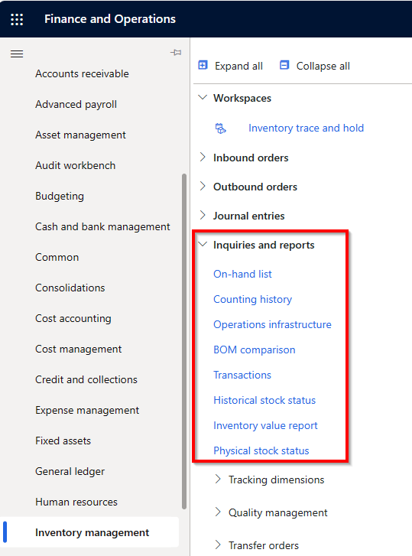
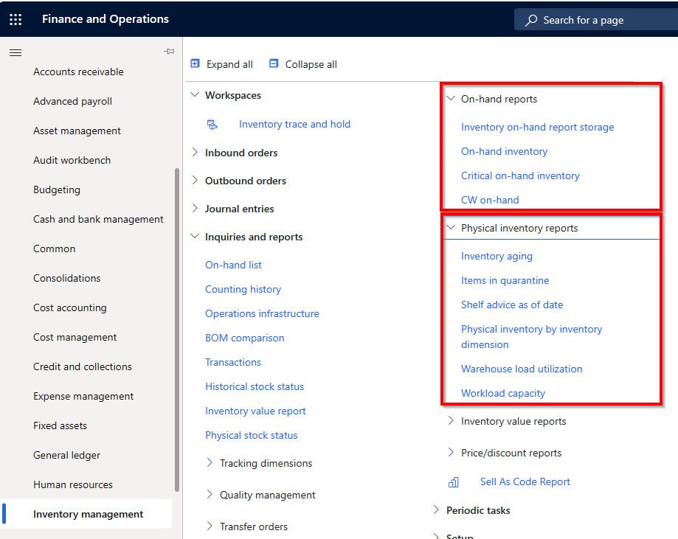
D365 F&O Out of the Box Reports
Where to find them:
Within the module >Inquiries and reports sections

Slide 12
Form Personalization
Adding Columns
Saved Views
Workspaces

Slide 13
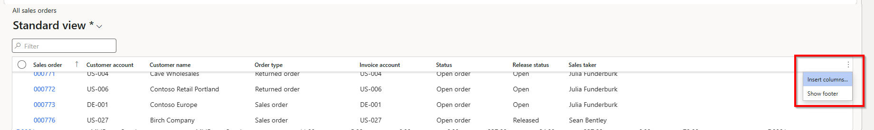
Adding Columns

Slide 14
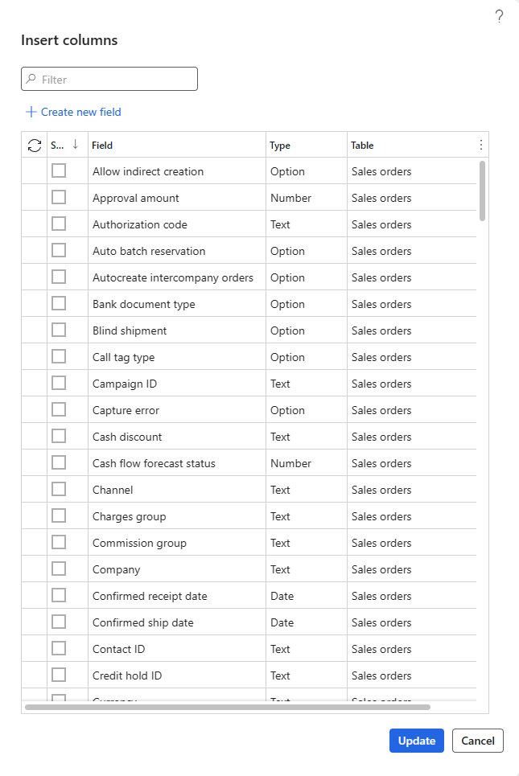
Adding Columns

Slide 15
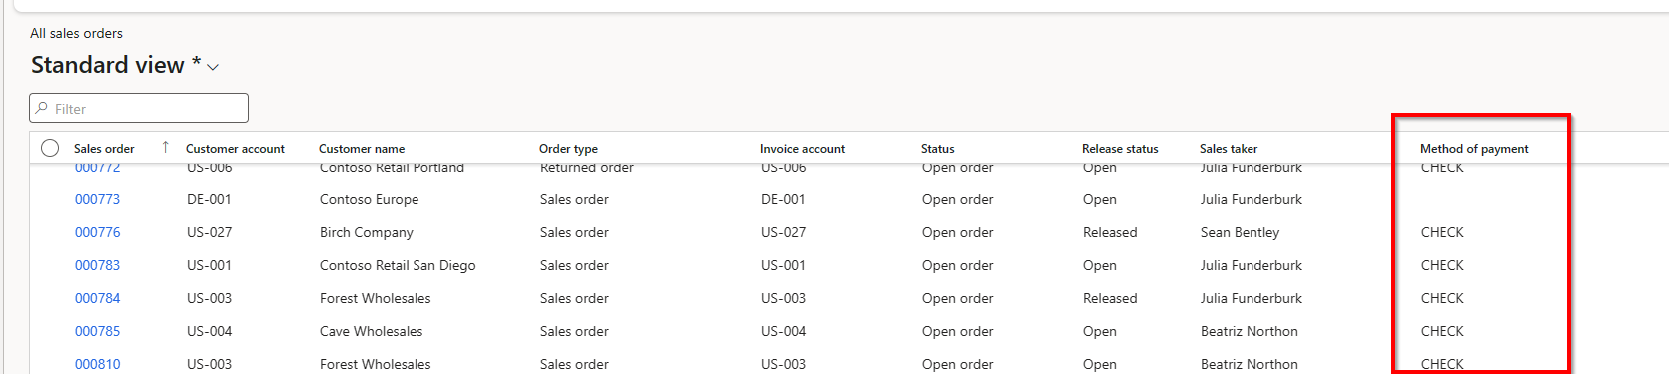
Adding Columns

Slide 16
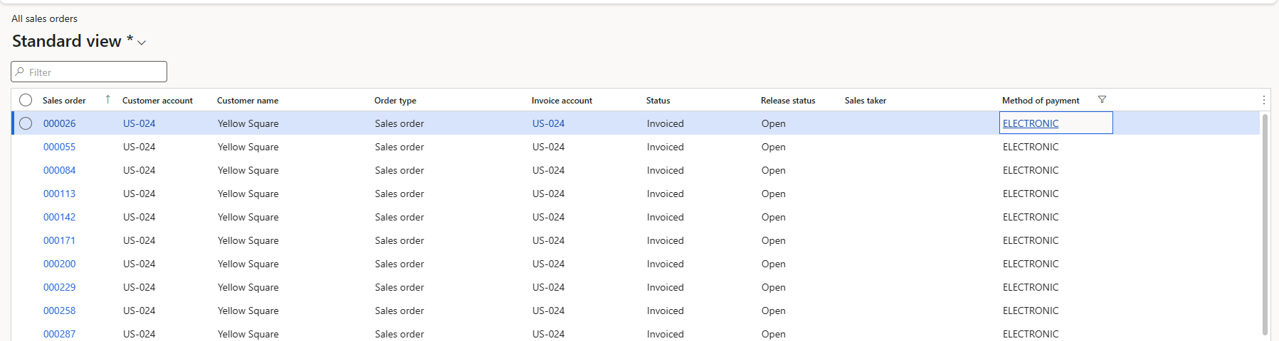
Saved Views

Slide 17
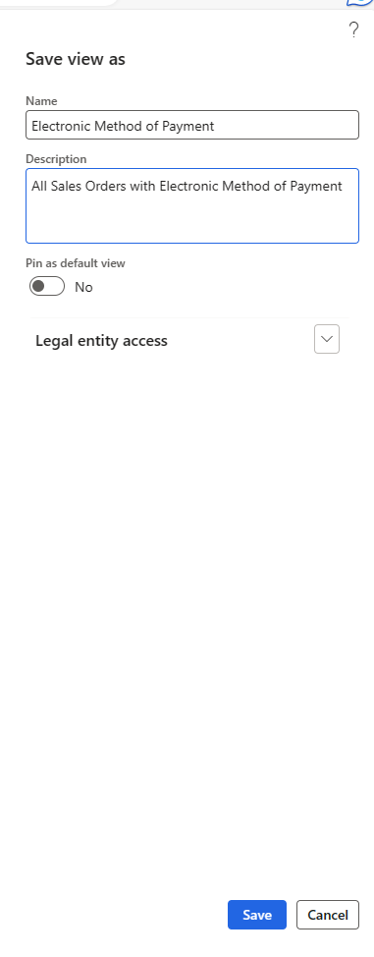
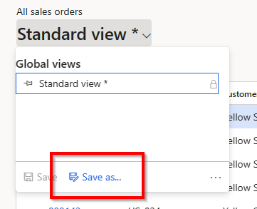
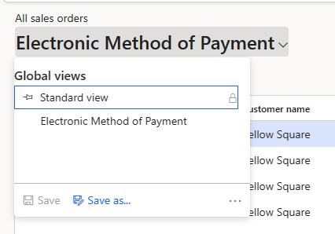
Saved Views

Slide 18
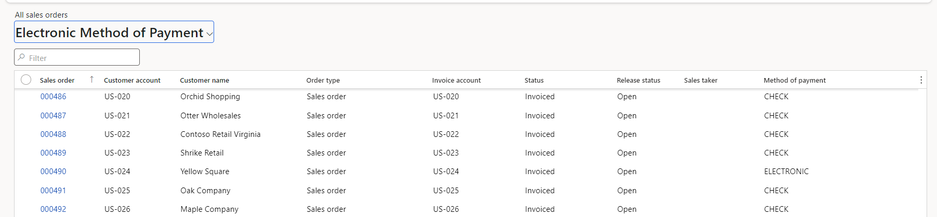
Saved Views

Slide 19
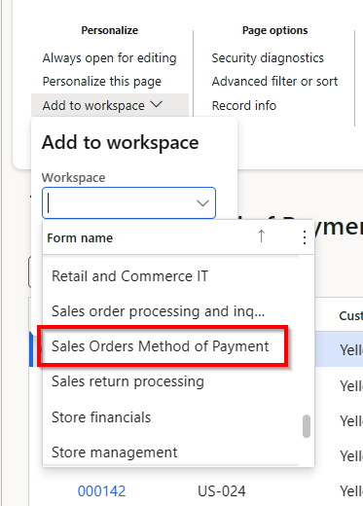
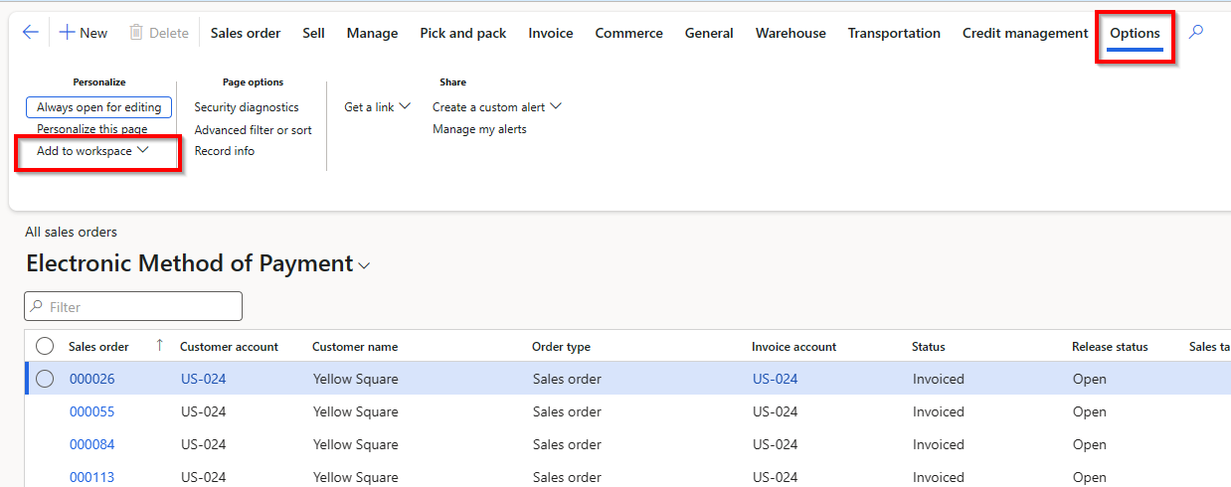
Workspaces

Slide 20
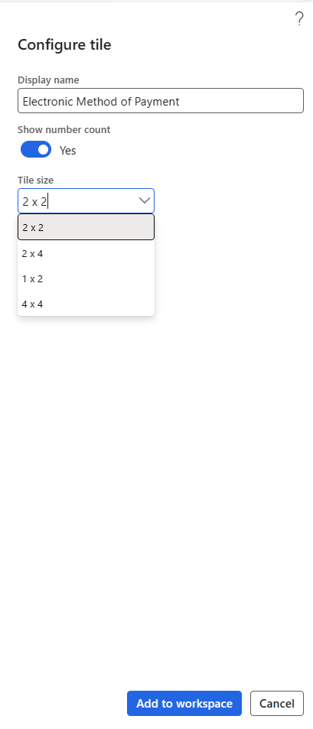
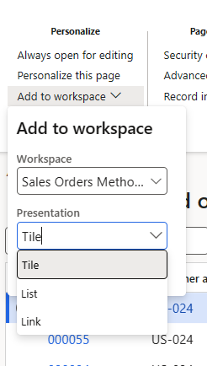
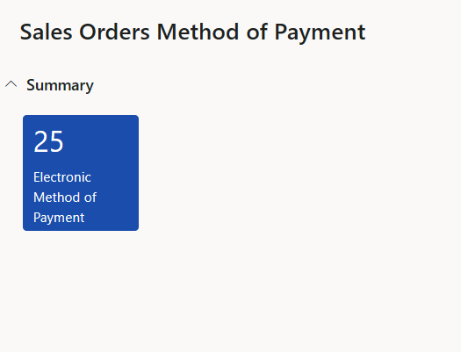
Workspaces

Slide 21
SSRS Additions/Updates
OOB Reports, such as Inventory Value
Table Joins – for missing columns
    Developer needed
Related Values-not available in a data set or OOB report
    Developer needed

Slide 22
When to build a report externally from D365
You need data that is not in D365 F&O
You need a configuration of data that is difficult to achieve off an D365 F&O data model
You need more complex measures and calculations (e.g., YoY) that are more intuitively developed through a Power BI data model than from a customization
AND- in real time is not required
Notes:
While you want to use the D365 reporting tools first when you can, there are plenty of instances where that’s just not possible or practical.
1- You will need to build reports externally from D365 when that report requires data that exists externally from D365. For example, you may need to incorporate data from a SharePoint list or use employ SQL logic to get higher-level groupings of certain fields that are available in D365 itself.
2. If the D365 FO data model doesn’t have pre-existing relationship and structure that will make your report easy to build in D365 itself, it may simply be easier to build the report externally than shoehorn additional logic into D365’s underlying data model
3. When you need a report that has more robust measures and calculations (such as time-intelligence based logic like year-on-year), you’ll generally find it simpler and faster to build it in Power BI than in D365 itself.
4. And, finally, when your report can tolerate some latency. Even when leveraging the Data Lake, each step away from the data source is going to add a little bit of friction between the D365 data source and the report. How much latency you can tolerate should help to inform whether it makes sense to build a report

Slide 23
OData - Excel
Option for informal reports where the data needs to be viewed/manipulated in excel
OData (from an entity in Dynamics)
  Excel wizards who just need the raw data
Not ideal for formal, repetitively used reports
Not for complex datasets/measures
Performance concerns at scale (use sparingly)
Notes:
OData is a great solution when you just need to view and analyze data in a one-off fashion. If you're already an Excel wizard and you either need to review the output in D365 (say to validate output during data migration) or you need to quickly update multiple fields in D365, this can be a great time saver.
That said, using OData in Excel isn't an ideal solution when you need a more formal report, particularly when you need to leverage it repeatedly and/or share it with others. The less wizard-like individuals will also find Odata more difficult to use and will often prefer self-service. If you need more robust datasets and measures to get the relevant output, this won't be an ideal solution—and Lenore can share anecdotally that she's run into issues with performance (or simply with the an excel workbook's Odata connection breaking over time) that makes this better for short-term solutions

Slide 24
Good data foundations = faster and better reports
Recommendations:
Leverage a data warehouse
Create 1 "golden" dataset
Treat security & data governance as “People” problems
Power BI Workspaces & Apps should reflect how your company works
Notes:
When it comes to developing reports externally from D365, start by taking a 60kft view of how your company would like to experience reports and what your internal capacity is for maintenance. Back in the early Power BI days, there was a strong push for democratizing data across departments and empowering individuals to create their own reports. While I love the spirit of this, that level of decentralization can lead to significant issues like:
- Meetings where four different departments come and argue about a number that

Slide 25

Use Paginated Reports (.rdl) when...
The report must be "pixel perfect" in PDF or Print form
Users may need to export up to 1M rows of data to Excel
Users need an operational report that requires minimal interaction/exploration
Notes:
While there are definitely situations where a report could be either a Power BI standard or a paginated report, there are some situations where paginated reports are the simply the right tool for the job:
1 – you have a report which will primarily be printed or PDFed and needs to be in a specific format. Maybe it's for a bank, or an auditor, or a board meeting. It may be possible to finangle something with a standard Power BI report, but you'll have a much easier time using paginated to get your desired output.
2- When a report is partially just an avenue to export a high volume of data (e.g., to support an audit) in a specific structure, make paginated report. Power BI standard is much more limited than paginated reports—in this instance, you'll have a much easier time using a paginated report to get the output you need.

Slide 26




Are paginated reports harder than standard Power BI reports???
Notes:
I truly don't believe that Paginated Reports are any harder than Power BI standard—though they are absolutely a separate skill that I think deserve way more attention than they receive. If paginated reports make you want to lay down and die, I encourage you to join me at the workshops I'll be holding this week to help you gain that Matt Damon-level confidence.

Slide 27
Real life example
Steve is a CFO who needs to be able to print the following report for quarterly board meetings. It will never be looked at on someone's phone.
Steve needs a paginated report built using Power BI Report Builder (AKA Paginated Report Builder)

Slide 28
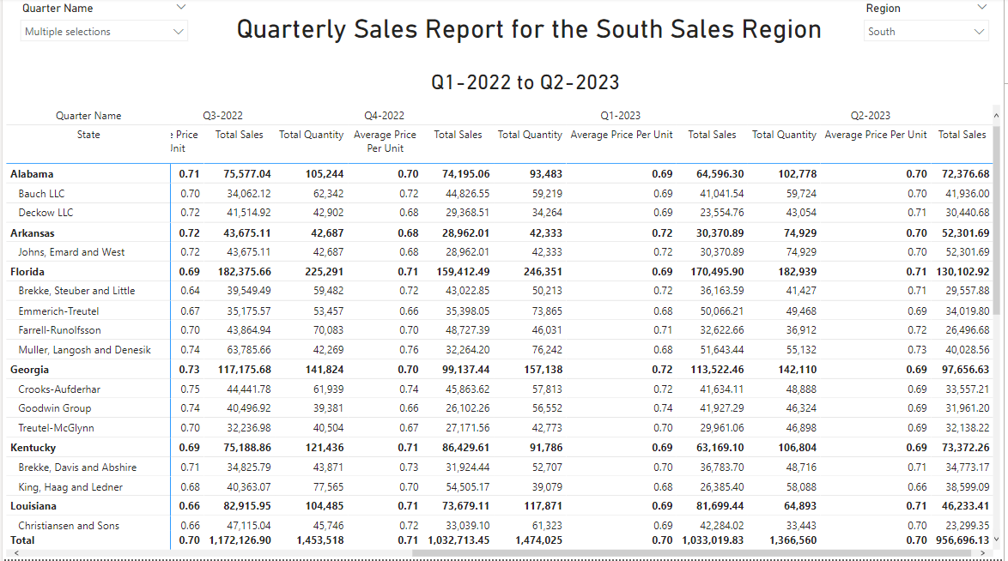
Notes:
Why not just have Steve use a Standard Power BI files? While they will print—but they’re only going to give you a snapshot of what you currently have visible,
including the scroll bars and
any of the slicers you’ve included on the reporting pane. I figured this out at about 8 hours before I needed this report printed out for every department. It was a real rough night.
So not only are you losing the data that you don’t have selected, the layout it funky to boot

Slide 29
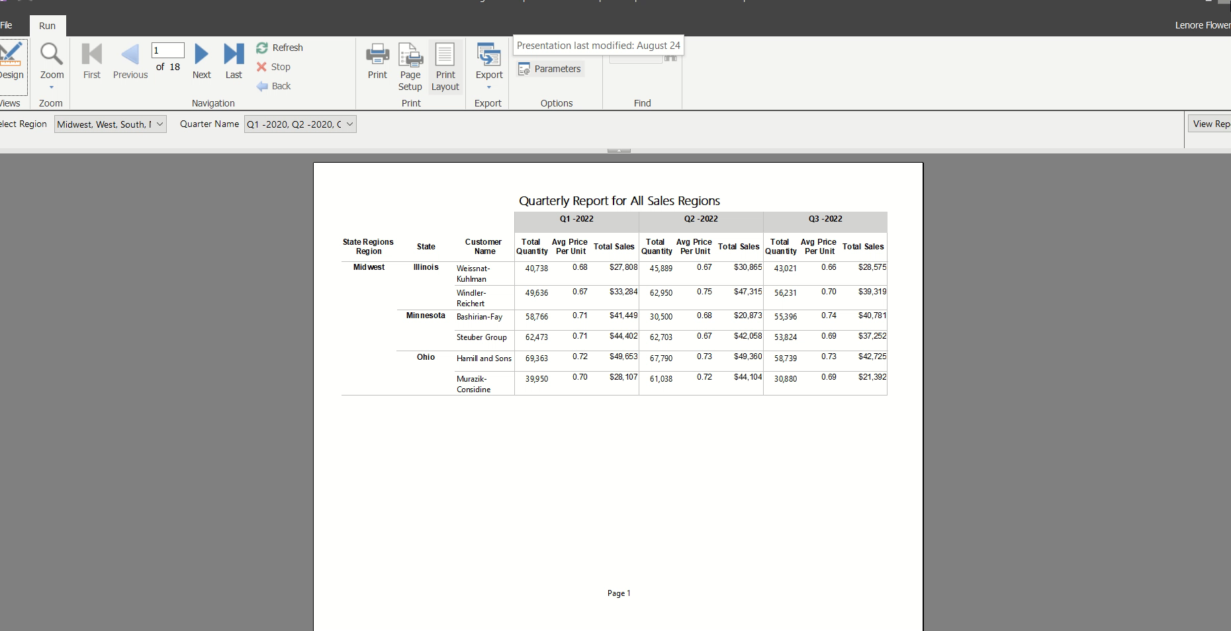

Slide 30
Use Power BI Reports (.pbix) when...
A report will be interacted with on screens of varying sizes
You want uses to explore their data using interactive slicers, drilldowns, what-if analysis, etc.
You never need to print
You never need to export more than 150K rows to Excel
Notes:
Standard Power BI Reports tend to be the first thing that folks think about when it comes to developing any reports at all. These are great tools when you need a highly dynamic report that will fit anything from a conference room screen to your cell phone

Slide 31
Recorded demo of a Power BI report goes here
Show a version of report one that has interactive components

Slide 32
Real life example
Lauren needs to be able to analyze whether a sale is profitable on her phone when she's deciding whether to close a deal using parameters and sliders.
Lauren needs a Standard Power BI report optimized for cell phones.

Slide 33
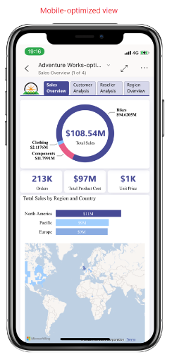
Mobile Report users? Mobile-optimized
Set up mobile-optimized versions of your Power BI reports when report users
Use reports to make key decisions “in the field”
Travel extensively for work
Express a strong preference to review data on-the-go
Screenshot shamelessly Stolen from Microsoft’s documentation
Notes:
Mobile optimized Power BI reports are just a different way of viewing a Power BI report. Often this is more of a nice to have, but there are some instances where having a mobile-optimized view will be crucial for report adoption, for example in instances where a report user will use the data in a report to approve or reject a sales bid. Staff who either travel extensively or are accustomed to analyzing data on their phones between meetings will benefit from a mobile-optimized version of a report.

Slide 34

Sometimes, the answer is “both!"
Paginated reports can be embedded in Power BI reports.
Same dataset and logic; different end user experiences.
Notes:
While creating two versions of a report may sound like twice the work, once you've designed the required fields, structure, measures, and data model to support one version of a report, you'll find it's actually pretty quick to create a second version that allows you to have your cake (be able to review data on your phone) and eat it too (print that report out when you need it in print form).
Often, clients get stuck on the either/or when the true solution is to spend a little more time giving the end report users access to both options.

Slide 35
Key take-aways
Reports are only as good as the underlying data, the team that you work with, and the questions you ask.
Teamwork makes the dream work😊
  There’s often multiple ways to solve a problem.
  Working collaboratively to find the right solution is often the best way to work through the gray areas.

Slide 36

Thank you for attending!
Lauren Wooll
  Caf2Code, l.wo21@caf2code.com
Lenore Flower
  Caf2Code, l.fl21@caf2code.com

Slide 37

© 2023 Dynamic Communities. All rights reserved.

