Slide 1
Manufacture Products, not Inventory Costing Mistakes in Dynamics 365 F&O (AX)
1.5 CPE credits available for this session
Please be sure to sign in at the clipboard
Presented by:
Brittany Burke & Lauren Wooll

Slide 2
Who are we?
Brittany Burke
Lauren Wooll
Solutions Architect
Masters in Accounting
Broad understanding of the roots of Financial transactions throughout all functions in D365
Loves to cook and bake all kinds of food with her 6-year-old son Declan
Functional Consultant II
Bachelors in Retailing
Passion and keen understanding for Product and Inventory Management within D365
Hails from Wisconsin- “Go Badgers!”

Slide 3
Who is Caf2Code?
Caf2Code is a boutique Dynamics 365 agency
“Positively impacting the world by helping businesses become more effective and efficient with innovation.”
We embody positive, can-do attitudes to achieve project milestones in accordance with helping the world!
Our key values of drive and integrity inspire us to deliver top quality solutions.

Slide 4
What is Inventory Value
Physical vs Financial Cost
Finance & Operations Alignment
Operational Process Mapping
Impacts from General Journals
Correcting Timing Mistakes
Corrections

Slide 5
What is Inventory Value?
The monetary amount associated with inventory at the end of an accounting period. This valuation is based on the costs incurred to acquire the inventory and get it ready for sale.

Slide 6
Physical Cost
vs
Financial Cost

Slide 7
Physical Cost
What is it?
The value that an item has to an organization as it sits in a site and warehouse
This is the value an organization defines based on the value it holds during different phases of its life
Examples include:
On its own as a finished good
Raw material as an input for manufacturing
Manufactured good- calculated based on how it was produced and valued internally

Slide 8
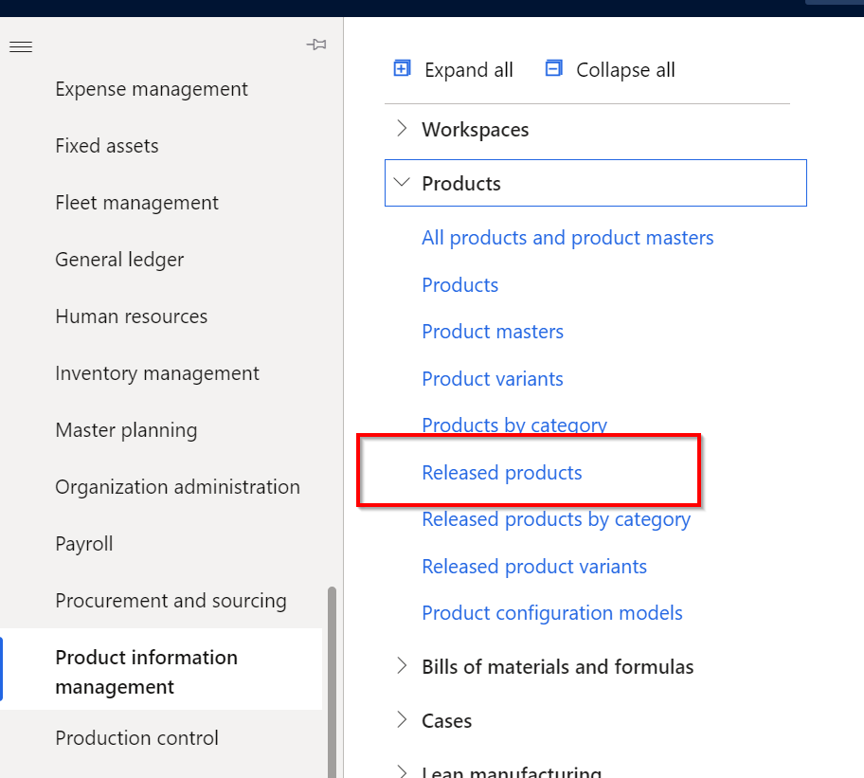
Physical Cost
Where does it come from in Dynamics?

Slide 9
Physical Cost
Where does it come from in Dynamics?

Slide 10
Physical Cost
Where does it come from in Dynamics?

Slide 11
Physical Cost
How to change it

Slide 12
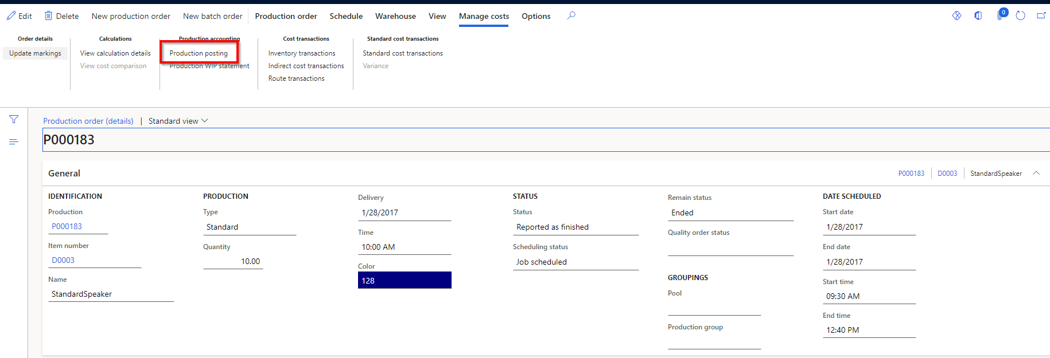
Physical Cost
Where is it used?
Reported as finished Journals

Slide 13
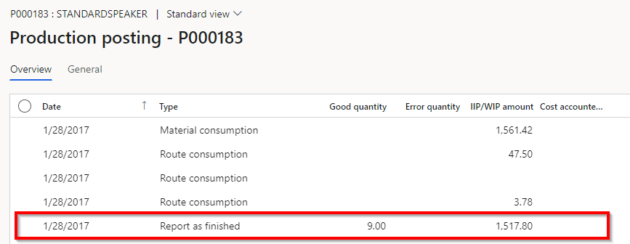
Physical Cost
Where is it used?

Slide 14
Physical Cost
Where is it used?

Slide 15
Physical Cost
Where is it used?
$168.64 per unit
X
9 units produced
=
$1,517.80

Slide 16
Financial Cost
What is it?
The real cost price determined by dynamics using the chosen financial accounting method
This can only be adjusted during the closing and adjustment periods
Estimate until inventory close is ran
Depending on the method chosen-
the financial cost calculation differs, but in the end will be the true cost of the good at that given time based on all the costs or steps incurred up until this point of sales or manufacturing completion
This financial cost is the price that is determined at the end of a manufacturing process, or at the time of invoicing

Slide 17
Financial Cost
Where does it come from in Dynamics?

Slide 18
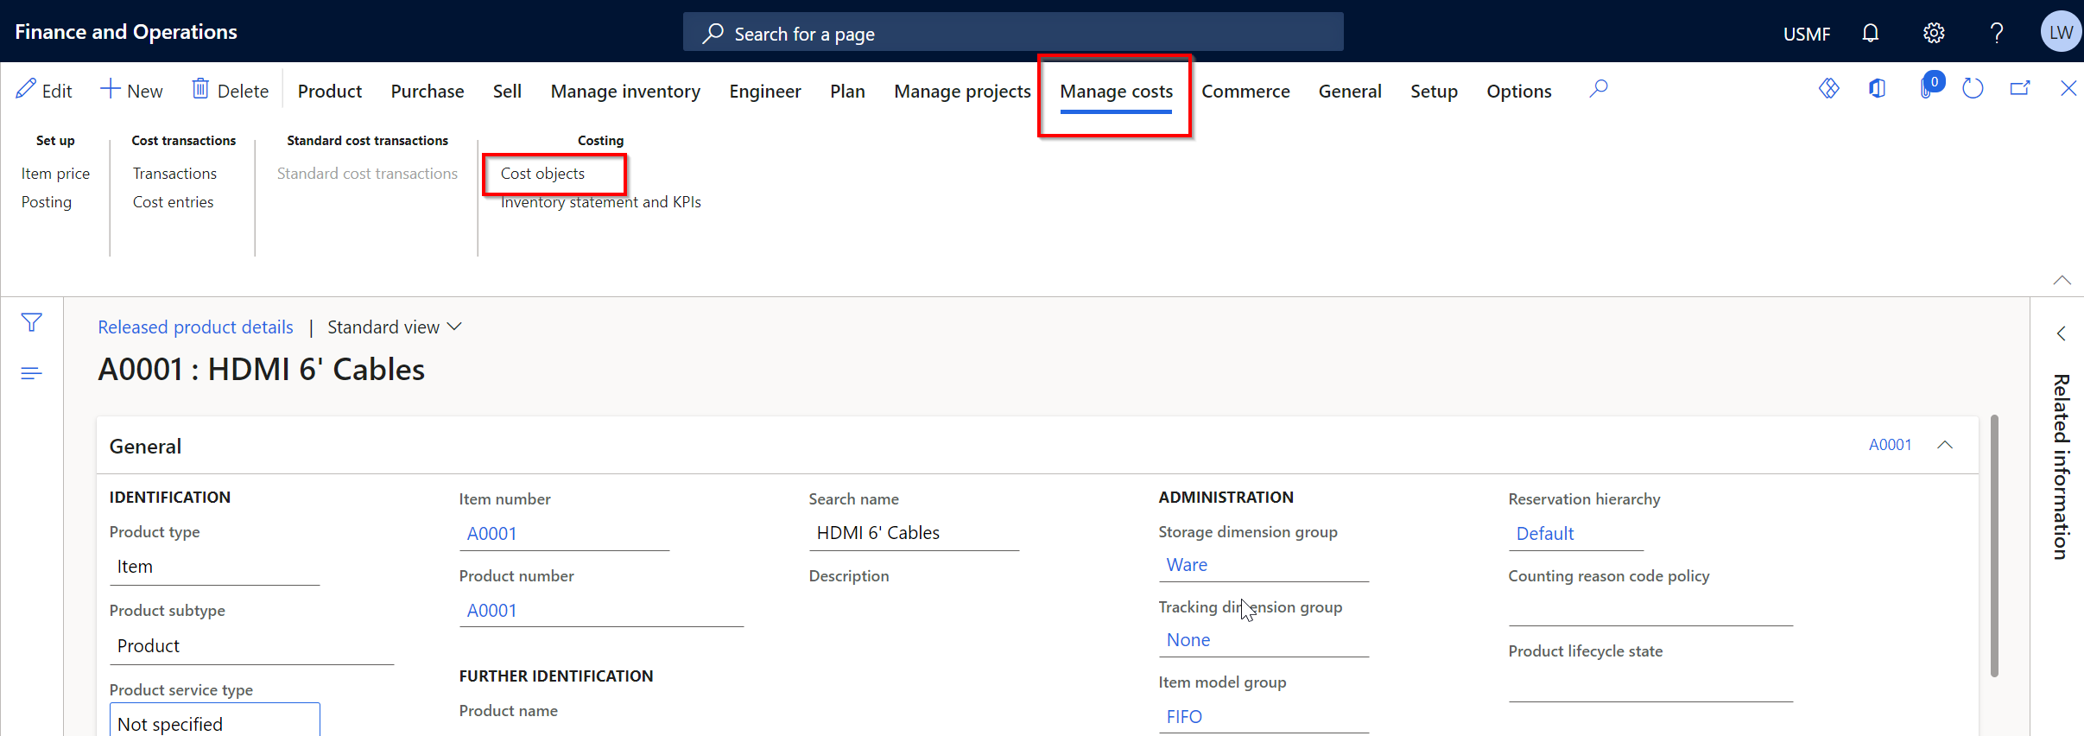
Financial Cost
Where does it come from in Dynamics?

Slide 19
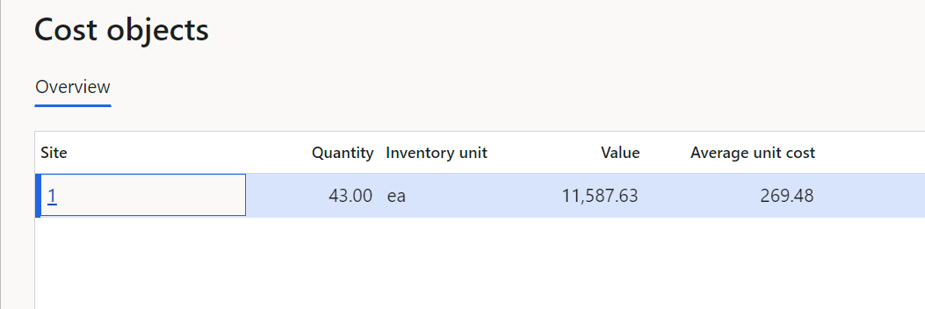
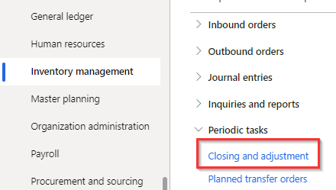
Financial Cost
Where does it come from in Dynamics?
How to change it?

Slide 20
Co-Products & By-Products
Co-Products
Products that are expected to come off the production run
Defined in the Formula
Costed out at the end of a production run the same as the formula products

Slide 21
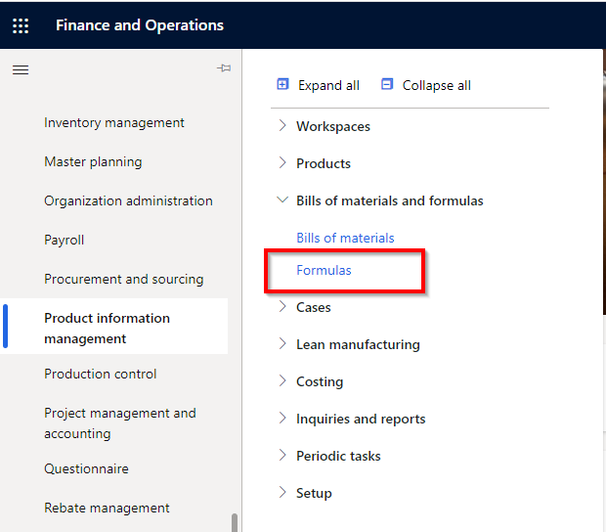
Co-Products & By-Products
Co-Products Setup

Slide 22
Co-Products & By-Products
Co-Products Setup

Slide 23
Co-Products & By-Products
Co-Products Setup

Slide 24
Co-Products & By-Products
Co-products Setup
None ─ No cost allocation is applicable for the co-product item
Manual ─ Use a cost allocation percentage. The percentage is specified in the corresponding Cost allocation percent field
TCA ─ The dynamic method that the system uses for production orders to assign a cost by the total quantity of formula products and co-products reported as finished during a production order or “run”

Slide 25
Co-Products & By-Products
By-Products
Referred to as “Burden” by the system
These are products that are not always produced by a production run but need to be determined on how they are dealt with from a costing standpoint
Defined with Co-Products within a formula

Slide 26
Co-Products & By-Products
By-Products

Slide 27
Co-Products & By-Products
By-Products

Slide 28
Co-Products & By-Products
By-Products
None ─ Always used for co-products
Percent ─ Cost of disposing of the by-product is a percentage of the total production cost
Per series ─ Burden amount is applied to the cost of the batch order, regardless of the quantity reported as finished
Per quantity ─ Burden is applied to the cost of the batch based on the quantity reported as finished

Slide 29
Finance & Operations Alignment

Slide 30
Finance & Operations Alignment
Alignment between Finance and Operations is critical to ensure accurate inventory value and GL reporting
The correct operational processes are just as important as correct financial configuration
Finance
Inventory Value
Operations

Slide 31
Finance & Operations Alignment
Operational Processes
Financial Configuration
Any process that results in the purchase, consumption, production or sale of inventory
Examples: Purchase Order, Production Order, Sales Order, Inventory Journals (Counting, Adjustment, Movement, etc)
Finance
Inventory Value
Operations
Posting Types
Defines the main account related to a specific transaction step
A single voucher will have more than one posting type
Posting Profiles
The collection of posting types for an item, item group, or legal entity that control how the subledger transactions are converted into main account postings

Slide 32
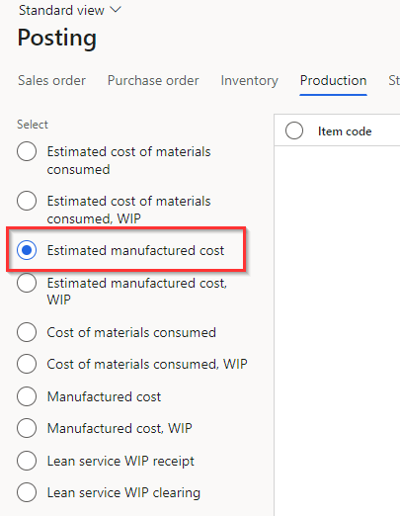
Operational Process Mapping
When is this posting type triggered?
Is it a DEBIT or a CREDIT?
Report as Finished Journal is posted
Finance
Ending the Production Order
Inventory Value
Operations
DEBIT – when the Report as Finished Journal is posted
CREDIT- when Ending the Production Order

Slide 33
Operational Process Mapping
Why is it important?
Ensure correct posting types are used during operational processes
Where to start?
Only conduct in a controlled non-production environment
Finance
Inventory Value
Operations

Slide 34
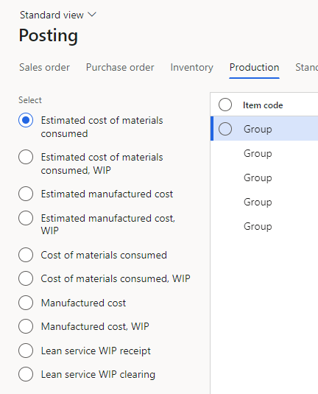
Operational Process Mapping
Perform Operational Step
Map Posting Type
Perform Operational Step
Map Posting Type
Map Operational Processes to Posting Type
Finance
Inventory Value
Operations
Update Posting Types to Align
Validate Financial Impacts Align with Expectations

Slide 35
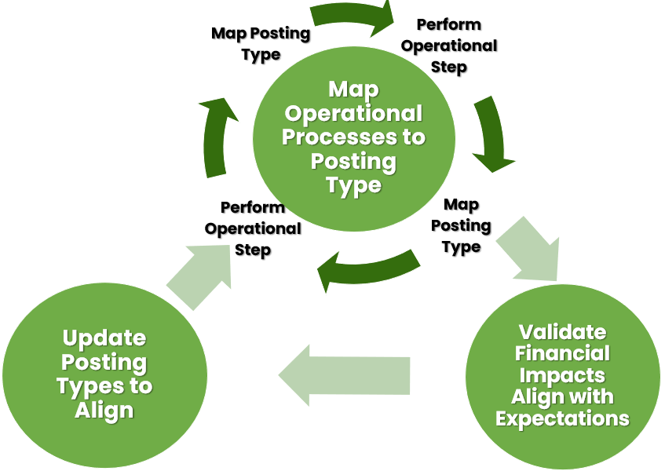
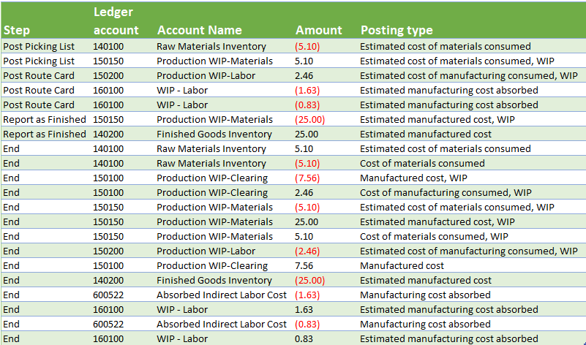
Map Operational Processes to Posting Type
For each step in the operational process, review voucher transactions to map posting types to operational steps
Note: Not all steps in inventory transactions produce vouchers, such as starting a production order

Slide 36
Validate Financial Impacts
How do I determine if posting types are correct?
At the completion of the operational process, do the balances end in the intended accounts and make sense?
Accounts Intended by Finance
Actual Results
Ledger account | Account Name | Debit or Credit
140100 | Raw Materials Inventory | Credit
140200 | Finished Goods Inventory | Debit
600522 | Absorbed Indirect Labor Cost | Credit
Ledger account | Account Name | Sum of Amount
140100 | Raw Materials Inventory | (5.10)
140200 | Finished Goods Inventory | 0.00
150100 | Production WIP-Clearing | 2.46
150150 | Production WIP-Materials | 5.10
600522 | Absorbed Indirect Labor Cost | (2.46)
Ledger account | Account Name | Sum of Amount
140100 | Raw Materials Inventory | (5.10)
140200 | Finished Goods Inventory | 0.00
150100 | Production WIP-Clearing | 2.46
150150 | Production WIP-Materials | 5.10
600522 | Absorbed Indirect Labor Cost | (2.46)

Slide 37
Validate Financial Impacts
How do I analyze posting type mapping for each step?
At the end of each operational step, do the balances end in the intended accounts and make sense?
There are a variety of ways and methods to review and analyze operational step mapping to GL accounts
140200 - Finished Goods Inventory | 150150 - Production WIP-Materials
Bal.
140200 - Finished Goods Inventory | 150150 - Production WIP-Materials
RAF | 25.00
Bal. | 25.00
140200 - Finished Goods Inventory | 150150 - Production WIP-Materials
RAF | 25.00 | 25.00 | End
Bal. | 0.00
140100 - Raw Materials Inventory | 150150 - Production WIP-Materials
Bal.
140200 - Finished Goods Inventory | 150150 - Production WIP-Materials
RAF | 25.00 | 25.00 | End
Bal. | 0.00
140100 - Raw Materials Inventory | 150150 - Production WIP-Materials
 |  | 5.10 | Picking List
Bal. |  | 5.10
140100 - Raw Materials Inventory | 150150 - Production WIP-Materials
End | 5.10 | 5.10 | Picking List
Bal. | 0.00
140100 - Raw Materials Inventory | 150150 - Production WIP-Materials
End | 5.10 | 5.10 | Picking List
 |  | 5.10 | End
Bal. |  | 5.10
150100 - Production WIP-Clearing | 150150 - Production WIP-Materials
Bal.
150100 - Production WIP-Clearing | 150150 - Production WIP-Materials
 |  | 7.56 | End
Bal. |  | 7.56
150100 - Production WIP-Clearing | 150150 - Production WIP-Materials
End | 2.46 | 7.56 | End
Bal. |  | 5.10
150100 - Production WIP-Clearing | 150150 - Production WIP-Materials
End | 2.46 | 7.56 | End
End | 7.56
Bal. | 2.46
150100 - Production WIP-Clearing | 150150 - Production WIP-Materials
End | 2.46 | 7.56 | End
End | 7.56
Bal. | 2.46
600522 - Absorbed Indirect Labor Cost | 150150 - Production WIP-Materials
Bal.
600522 - Absorbed Indirect Labor Cost | 150150 - Production WIP-Materials
 |  | 1.63 | End
Bal. |  | 1.63
600522 - Absorbed Indirect Labor Cost | 150150 - Production WIP-Materials
 |  | 1.63 | End
 |  | 0.83 | End
Bal. |  | 2.46
150150 - Production WIP-Materials | 150150 - Production WIP-Materials
Bal.
150150 - Production WIP-Materials | 150150 - Production WIP-Materials
Picking List | 5.10
Bal. | 5.10
150150 - Production WIP-Materials | 150150 - Production WIP-Materials
Picking List | 5.10 | 25.00 | RAF
Bal. |  | 19.90
150150 - Production WIP-Materials | 150150 - Production WIP-Materials
Picking List | 5.10 | 25.00 | RAF
 |  | 5.10 | End
Bal. |  | 25.00
150150 - Production WIP-Materials | 150150 - Production WIP-Materials
Picking List | 5.10 | 25.00 | RAF
End | 25.00 | 5.10 | End
Bal. | 0.00
150150 - Production WIP-Materials | 150150 - Production WIP-Materials
Picking List | 5.10 | 25.00 | RAF
End | 25.00 | 5.10 | End
End | 5.10
Bal. | 5.10
150150 - Production WIP-Materials | 150150 - Production WIP-Materials
Picking List | 5.10 | 25.00 | RAF
End | 25.00 | 5.10 | End
End | 5.10
Bal. | 5.10
150200 - Production WIP-Labor | 150150 - Production WIP-Materials
Bal.
150200 - Production WIP-Labor | 150150 - Production WIP-Materials
Route Card | 2.46
Bal. | 2.46
150200 - Production WIP-Labor | 150150 - Production WIP-Materials
Route Card | 2.46 | 2.46 | End
Bal. | 0.00
160100 - WIP - Labor | 150150 - Production WIP-Materials
Bal.
160100 - WIP - Labor | 150150 - Production WIP-Materials
 |  | 1.63 | Route Card
Bal. |  | 1.63
160100 - WIP - Labor | 150150 - Production WIP-Materials
 |  | 1.63 | Route Card
 |  | 0.83 | Route Card
Bal. |  | 2.46
160100 - WIP - Labor | 150150 - Production WIP-Materials
End | 1.63 | 1.63 | Route Card
 |  | 0.83 | Route Card
Bal. |  | 0.83
160100 - WIP - Labor | 150150 - Production WIP-Materials
End | 1.63 | 1.63 | Route Card
End | 0.83 | 0.83 | Route Card
Bal. | 0.00

Slide 38
Update Posting Types to Align
Step | Ledger account | Account Name | Amount | Posting type
Post Picking List | 140100 | Raw Materials Inventory | (5.10) | Estimated cost of materials consumed
Post Picking List | 150150 | Production WIP-Materials | 5.10 | Estimated cost of materials consumed, WIP
Post Route Card | 150200 | Production WIP-Labor | 2.46 | Estimated cost of manufacturing consumed, WIP
Post Route Card | 160100 | WIP - Labor | (1.63) | Estimated manufacturing cost absorbed
Post Route Card | 160100 | WIP - Labor | (0.83) | Estimated manufacturing cost absorbed
Report as Finished | 150150 | Production WIP-Materials | (25.00) | Estimated manufactured cost, WIP
Report as Finished | 140200 | Finished Goods Inventory | 25.00 | Estimated manufactured cost
End | 140100 | Raw Materials Inventory | 5.10 | Estimated cost of materials consumed
End | 140100 | Raw Materials Inventory | (5.10) | Cost of materials consumed
End | 150100 | Production WIP-Clearing | (7.56) | Manufactured cost, WIP
End | 150100 | Production WIP-Clearing | 2.46 | Cost of manufacturing consumed, WIP
End | 150150 | Production WIP-Materials | (5.10) | Estimated cost of materials consumed, WIP
End | 150150 | Production WIP-Materials | 25.00 | Estimated manufactured cost, WIP
End | 150150 | Production WIP-Materials | 5.10 | Cost of materials consumed, WIP
End | 150200 | Production WIP-Labor | (2.46) | Estimated cost of manufacturing consumed, WIP
End | 150100 | Production WIP-Clearing | 7.56 | Manufactured cost
End | 140200 | Finished Goods Inventory | (25.00) | Estimated manufactured cost
End | 600522 | Absorbed Indirect Labor Cost | (1.63) | Manufacturing cost absorbed
End | 160100 | WIP - Labor | 1.63 | Estimated manufacturing cost absorbed
End | 600522 | Absorbed Indirect Labor Cost | (0.83) | Manufacturing cost absorbed
End | 160100 | WIP - Labor | 0.83 | Estimated manufacturing cost absorbed
Step | Ledger account | Account Name | Amount | Posting type
Post Picking List | 140100 | Raw Materials Inventory | (5.10) | Estimated cost of materials consumed
Post Picking List | 150150 | Production WIP-Materials | 5.10 | Estimated cost of materials consumed, WIP
Post Route Card | 150200 | Production WIP-Labor | 2.46 | Estimated cost of manufacturing consumed, WIP
Post Route Card | 160100 | WIP - Labor | (1.63) | Estimated manufacturing cost absorbed
Post Route Card | 160100 | WIP - Labor | (0.83) | Estimated manufacturing cost absorbed
Report as Finished | 150150 | Production WIP-Materials | (25.00) | Estimated manufactured cost, WIP
Report as Finished | 140200 | Finished Goods Inventory | 25.00 | Estimated manufactured cost
End | 140100 | Raw Materials Inventory | 5.10 | Estimated cost of materials consumed
End | 140100 | Raw Materials Inventory | (5.10) | Cost of materials consumed
End | 150100 | Production WIP-Clearing | (7.56) | Manufactured cost, WIP
End | 150100 | Production WIP-Clearing | 2.46 | Cost of manufacturing consumed, WIP
End | 150150 | Production WIP-Materials | (5.10) | Estimated cost of materials consumed, WIP
End | 150150 | Production WIP-Materials | 25.00 | Estimated manufactured cost, WIP
End | 150150 | Production WIP-Materials | 5.10 | Cost of materials consumed, WIP
End | 150200 | Production WIP-Labor | (2.46) | Estimated cost of manufacturing consumed, WIP
End | 150100 | Production WIP-Clearing | 7.56 | Manufactured cost
End | 140200 | Finished Goods Inventory | (25.00) | Estimated manufactured cost
End | 600522 | Absorbed Indirect Labor Cost | (1.63) | Manufacturing cost absorbed
End | 160100 | WIP - Labor | 1.63 | Estimated manufacturing cost absorbed
End | 600522 | Absorbed Indirect Labor Cost | (0.83) | Manufacturing cost absorbed
End | 160100 | WIP - Labor | 0.83 | Estimated manufacturing cost absorbed
Step | Ledger account | Account Name | Amount | Posting type
Post Picking List | 140100 | Raw Materials Inventory | (5.10) | Estimated cost of materials consumed
Post Picking List | 150150 | Production WIP-Materials | 5.10 | Estimated cost of materials consumed, WIP
Post Route Card | 150200 | Production WIP-Labor | 2.46 | Estimated cost of manufacturing consumed, WIP
Post Route Card | 160100 | WIP - Labor | (1.63) | Estimated manufacturing cost absorbed
Post Route Card | 160100 | WIP - Labor | (0.83) | Estimated manufacturing cost absorbed
Report as Finished | 150150 | Production WIP-Materials | (25.00) | Estimated manufactured cost, WIP
Report as Finished | 140200 | Finished Goods Inventory | 25.00 | Estimated manufactured cost
End | 140100 | Raw Materials Inventory | 5.10 | Estimated cost of materials consumed
End | 140100 | Raw Materials Inventory | (5.10) | Cost of materials consumed
End | 150150 | Production WIP-Materials | (7.56) | Manufactured cost, WIP
End | 150150 | Production WIP-Materials | 2.46 | Cost of manufacturing consumed, WIP
End | 150150 | Production WIP-Materials | (5.10) | Estimated cost of materials consumed, WIP
End | 150150 | Production WIP-Materials | 25.00 | Estimated manufactured cost, WIP
End | 150150 | Production WIP-Materials | 5.10 | Cost of materials consumed, WIP
End | 150200 | Production WIP-Labor | (2.46) | Estimated cost of manufacturing consumed, WIP
End | 140200 | Finished Goods Inventory | 7.56 | Manufactured cost
End | 140200 | Finished Goods Inventory | (25.00) | Estimated manufactured cost
End | 600522 | Absorbed Indirect Labor Cost | (1.63) | Manufacturing cost absorbed
End | 160100 | WIP - Labor | 1.63 | Estimated manufacturing cost absorbed
End | 600522 | Absorbed Indirect Labor Cost | (0.83) | Manufacturing cost absorbed
End | 160100 | WIP - Labor | 0.83 | Estimated manufacturing cost absorbed
Ledger account | Account Name | Sum of Amount
140100 | Raw Materials Inventory | (5.10)
140200 | Finished Goods Inventory | 7.56
150150 | Production WIP-Materials | 0.00
150200 | Production WIP-Labor | 0.00
160100 | WIP - Labor | 0.00
600522 | Absorbed Indirect Labor Cost | (2.46)

Slide 39
Corrections to Posting Types
Prior to Go-Live
Ensure the updated posting type changes are added to master configuration to be applied to Production for Go-Live
Be sure to re-validate that posting types are mapped properly during each iteration of testing prior to Go-Live

Slide 40
Corrections to Posting Types
Post Go-Live
Determine the best timing to implement changes to posting types in Production. The beginning of a new month may be your best option. Document the timing for future reference.
Review transactions and balances that remain as a result of the previously misaligned posting types
Be sure to test any reclass processes in a Non-Production environment to ensure desired results
Utilize Inventory Adjustment Journals to move inventory value and quantity from one main account to another

Slide 41
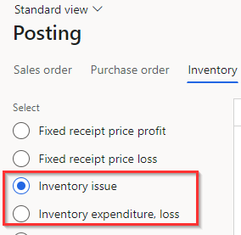
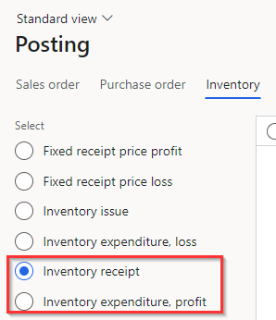
Corrections to Posting Types
Inventory Adjustment Journals
For Inventory Adjustment Journals, the posting types are used to determine how transactions will hit the GL
Inventory Issue will determine where negative quantities will be posted
Inventory Receipt will determine where positive quantities will be posted
Inventory Expenditure, loss and Inventory Expenditure, profit will determine the expense account to offset with inventory
Values used for Negative Adjustment Line unit costs will be determined by the Costing Method assigned to the items

Slide 42
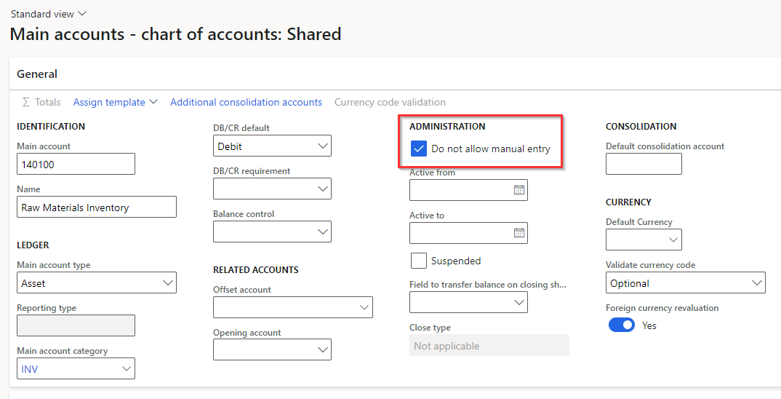
Impacts from General Journals
Use Inventory Transactions instead of General Journals when possible
Reversing General Journal entries may be appropriate in certain situations
Use Main Account Configuration to block manual entry for Inventory Accounts
This configuration will prompt additional thought when a general journal to inventory accounts is created

Slide 43
Impacts from General Journals
“Start on the Right Foot”
Prior period ending balances are commonly entered into D365 F&O before Go-live for reporting purposes
Be sure to fully reverse out balances in Inventory Accounts prior to entering any Inventory Transactions

Slide 44
Corrections

Slide 45
Correcting Timing Mistakes
Issue: Inventory Transactions posted to a wrong period (year or month)
A user entered production order transactions with a date of 1/1/2022 instead of 12/31/2021

Slide 46
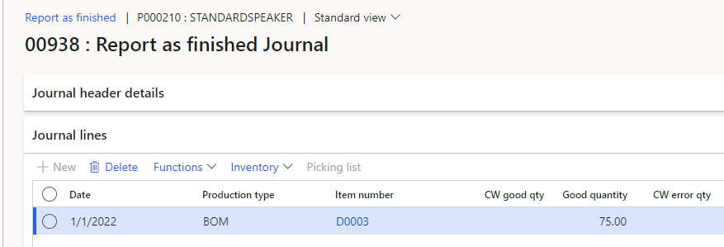
Correcting Timing Mistakes
How do I fix timing mistakes for Physical transactions?
Report as Finished Journal posted with a date of 1/1/2022, but it should have been posted to 12/31/2021- the Production Order has not been ended

Slide 47
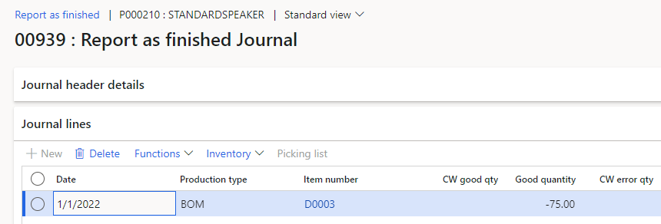
Correcting Timing Mistakes
How do I fix timing mistakes for Physical transactions?
Enter new Report as Finished journal for the same quantity, but negative on the same incorrect date

Slide 48
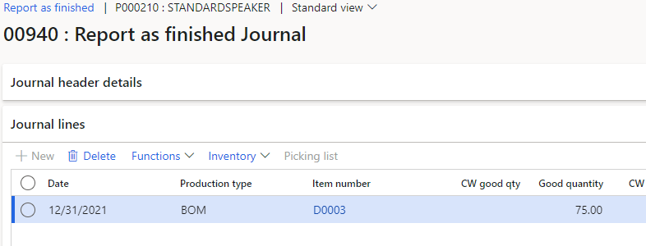
Correcting Timing Mistakes
How do I fix timing mistakes for Physical transactions?
Re-enter Report as Finished Journal with the correct date and positive quantity

Slide 49
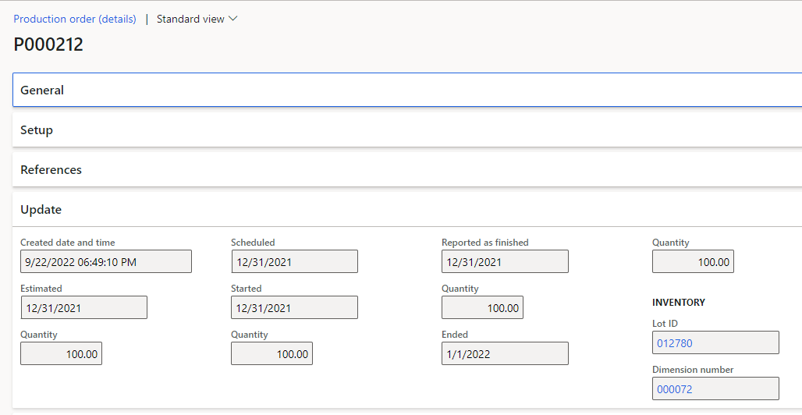
Correcting Timing Mistakes
How do I fix timing mistakes for Financial transactions?
Production order was Ended with a date of 1/1/2022, but it should have been Ended on 12/31/2021

Slide 50
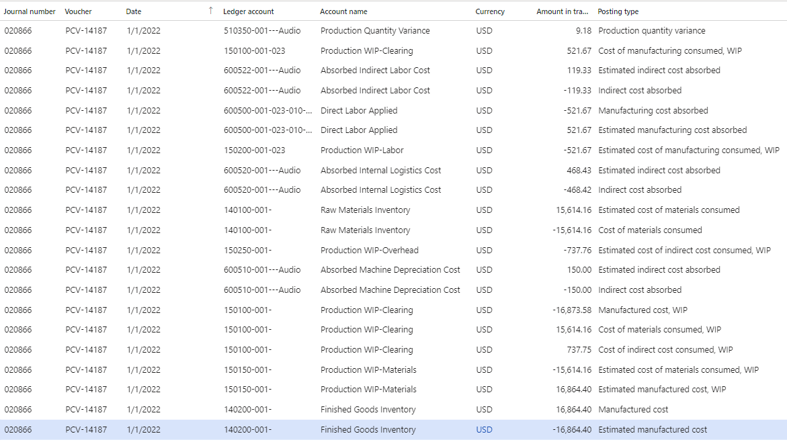
Correcting Timing Mistakes
How do I fix timing mistakes for Financial transactions?
Main Account | Sum of Amount
140100-001- | 0.00
140200-001- | 0.00
150100-001- | (521.67)
150100-001-023 | 521.67
150150-001- | 1,250.24
150200-001-023 | (521.67)
150250-001- | (737.76)
510350-001---Audio | 9.18
600500-001-023-010-Audio | 0.00
600510-001---Audio | 0.00
600520-001---Audio | 0.01
600522-001---Audio | 0.00

Slide 51
Correcting Timing Mistakes
How do I fix timing mistakes for Financial transactions?
Since the Production order was Reported as Finished on the correct date (12/31/2021) the inventory quantity is hitting the correct date, and only account balances need to be moved

Slide 52
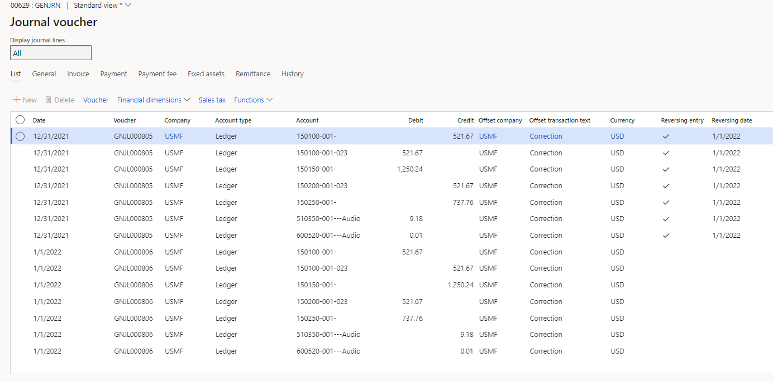
Correcting Timing Mistakes
How do I fix timing mistakes for Financial transactions?
Create a reversing General Journal entry to move account balances from the wrong period to the correct period
Main Account | Sum of Amount
1/1/2022
140100-001- | 0.00
140200-001- | 0.00
150100-001- | 0.00
150100-001-023 | 0.00
150150-001- | 0.00
150200-001-023 | 0.00
150250-001- | 0.00
510350-001---Audio | 0.00
600500-001-023-010-Audio | 0.00
600510-001---Audio | 0.00
600520-001---Audio | 0.00
600522-001---Audio | 0.00
12/31/2021
150100-001- | -521.67
150100-001-023 | 521.67
150150-001- | 1250.24
150200-001-023 | -521.67
150250-001- | -737.76
510350-001---Audio | 9.18
600520-001---Audio | 0.01

Slide 53
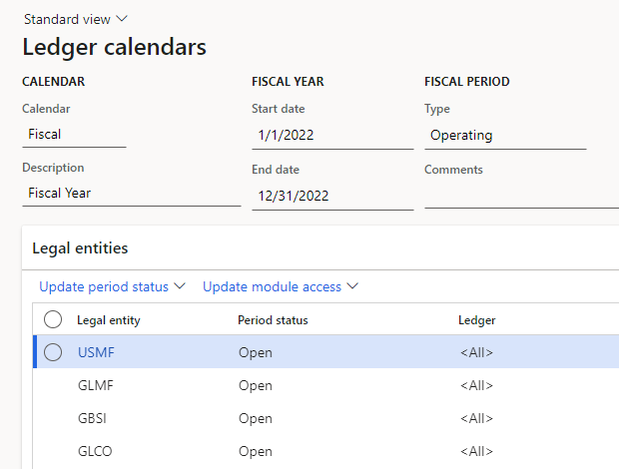
Correcting Timing Mistakes
Prevention and Risk Management
Put Ledger Periods on hold at the right time
Utilize user groups to limit access to open ledger periods in the past/future
Run Inventory Close monthly
Use standard or custom security to ensure users that should not be maintaining posting types cannot do so

Slide 54
Documentation of Corrections
Documentation of corrections is key
Audit support
Instructions for future occurrence of similar issues
Saves your company time, money, and resources
Training materials and knowledge transfers
Determine if prevention or detection measures are right for your company

Slide 55
Corrections not Questions
If you believe your inventory is valued incorrectly- what do you do?
Don’t make any rash changes
Take time to review how those changes will impact your value, costing, and company
Make proposed changes in a non-production environment first
Feature Management may provide possible solution
Don’t be afraid to ask for help

Slide 56
Questions?
Want to talk further or contact us?
Scan here:
Detailed session notes and presentation are also available via scan

Slide 57
Manufacture Products, not Inventory Costing Mistakes in Dynamics 365 F&O (AX)
October 11, 2022
Session Survey

